Slide 1
Chapter Two
End to End Machine Learning Project
Md. Abu Naser Mojumder
Assistant Professor
Computer Science and Engineering
Sylhet Engineering College

Slide 2
Model’s Performance Measure Techniques
For Classification:
For Regression:
Confusion Matrix
Accuracy
Precision
Recall
F1 Score
Mean Squared Error (MSE)
Root Mean Square Error (RMSE)
Mean Absolute Error (MAE)

Slide 3
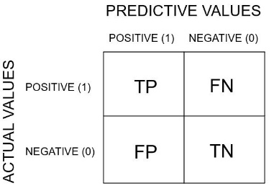
Confusion Matrix
Consider a classification model used to generate the result(see figure):
The blue points are labelled positive.
The red points are labelled negative.
Confusion Matrix Template:
Blue Type (Positive Type)
Red Type (Negative Type)

Slide 4
Confusion Matrix(cont..)
Making the Confusion Matrix:
True Positive: 6 blue above line. (TP)
True Negative: 5 red below line. (TN)
False Positive: 2 red above line (FP)
False Negative: 1 blue below line. (FN)
 | Predicted Blues | Predicted Reds
Actual Blues | 6 (TP) | 1 (FN)
Actual Reds | 2 (FP) | 5 (TN)
Blue Type (Positive Type)
Total Predictions : 14
Total Right Predictions: (TP+TN) 6+5 = 11
Total Wrong Predictions: (FP+FN) 2+1 = 3
Red Type (Negative Type)

Slide 5

Accuracy
Accuracy is one of the ways to measure how good a model is.
Lets calculate the accuracy of the previous example from Confusion Matrix:
$$Accuracy=\frac{Number of Correct Predictions}{Total Number of Predictions }$$
$=\frac{TP+TN}{TP+TN+FP+FN}$
$=\frac{6+5}{6+5+2+1}$
= $\frac{11}{14}$
$=0.786 ∗ 100\%$
Accuracy $=78.6\%$
 | Predicted Blues | Predicted Reds
Actual Blues | 6 (TP) | 1 (FN)
Actual Reds | 2 (FP) | 5 (TN)
Confusion Matrix

Slide 6
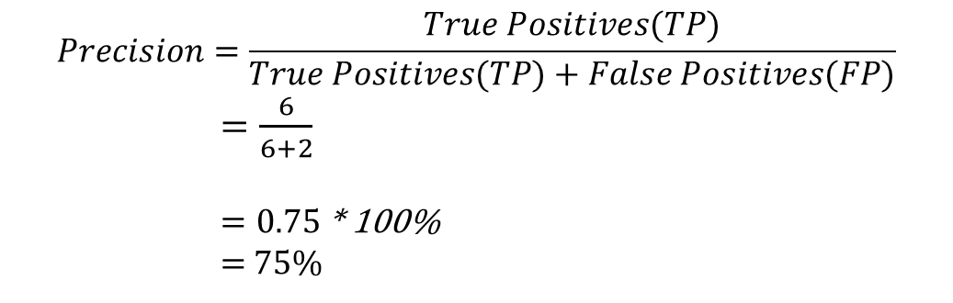
Precision
Precision is defined as the proportion of data that was predicted positive to the data was actually positive.
It says how good your model can classify True Positive compared to False positive
$$Precision=\frac{True Positives(TP)}{True Positives(TP)+False Positives(FP)}$$
$=\frac{6}{6+2}$
$=0.75$ * 100%
= 75%
 | Predicted Blues | Predicted Reds
Actual Blues | 6 (TP) | 1 (FN)
Actual Reds | 2 (FP) | 5 (TN)
Confusion Matrix

Slide 7
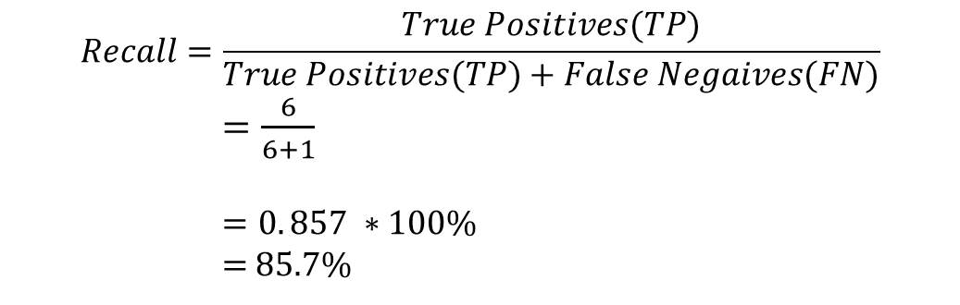
Recall
Recall is defined as the proportion of data that was predicted positive to the total positive(TP+FN). Recall attempt to answer the following question-
What proportion of actual positives was identified correctly?
$$Recall=\frac{True Positives(TP)}{True Positives(TP)+False Negaives(FN)}$$
$=\frac{6}{6+1}$
$=0. 857 ∗100\%$
= 85.7%
 | Predicted Blues | Predicted Reds
Actual Blues | 6 (TP) | 1 (FN)
Actual Reds | 2 (FP) | 5 (TN)
Confusion Matrix

Slide 8
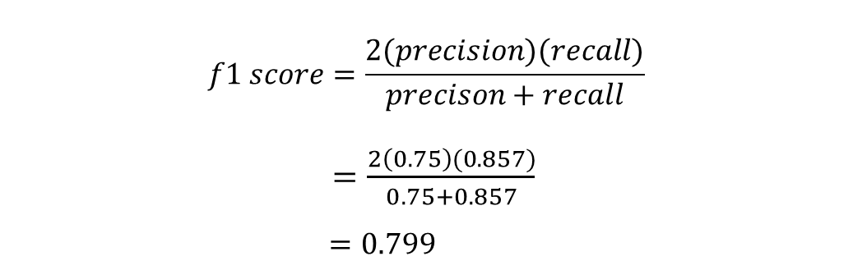
F1 Score
F1 score is combining both the Precision and Recall into a single metric for simplicity. It is the harmonic mean of the model’s precision and recall.
$$f1 score=\frac{2(precision)(recall)}{precison+recall}$$
$=\frac{2\left(0.75\right)(0.857)}{0.75+0.857}$
$=0.799$
Precision | Recall
0.75 | 0.857
From Previous example

Slide 9
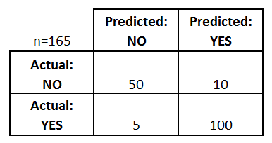
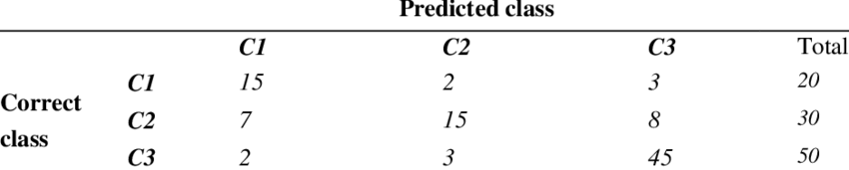
Exercise
1. Find Accuracy, Precision, Recall and F1 Score from the given confusion matrix below
2. Find Accuracy, Precision, Recall and F1 Score from the given confusion matrix below

Slide 10
Exercise
1. Find Accuracy, Precision, Recall and F1 Score from the given confusion matrix below
2. Find Accuracy, Precision, Recall and F1 Score from the given confusion matrix below

Slide 11

Mean Squared Error (MSE)
Mean Squared Error, or MSE for short, is a popular error metric for regression problems.
The MSE is calculated as the mean or average of the squared differences between predicted and expected target values in a dataset.
Where is the i’th expected value in the dataset and is the i’th predicted value. The difference between these two values is squared, which has the effect of removing the sign, resulting in a positive error value.

Slide 12
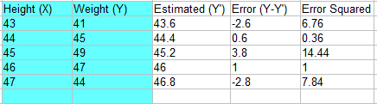
Mean Squared Error (MSE) contd…
Example: Given Height and Weight of some people (X, Y) : (43,41), (44,45), (45,49), (46,47), (47,44). Our model predicted the Weights as 43.6, 44.4, 45.2, 46, 46.8. Calculate the MSE from it.
Solution: From given data we can prepare the table.
Add all of the squared errors up: 6.76 + 0.36 + 14.44 + 1 + 7.84 = 30.4.
Find the mean squared error : 30.4 / 5
MSE = 6.08

Slide 13
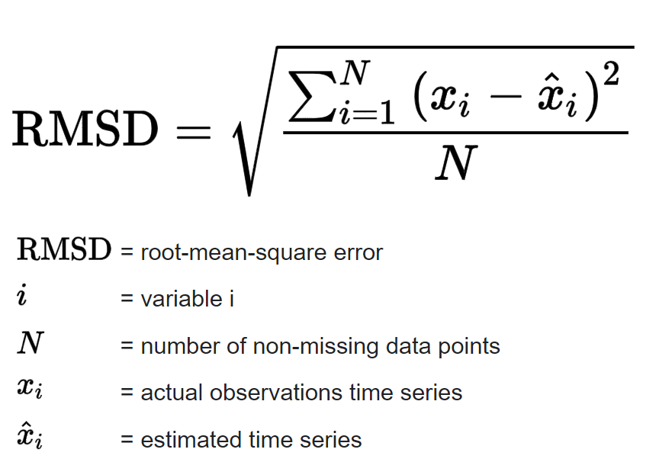
Root Mean Square Error (RMSE)
One way to assess how well a regression model fits a dataset is to calculate the root mean square error, which is a metric that tells us the average distance between the predicted values from the model and the actual values in the dataset.
The lower the RMSE, the better a given model is able to “fit” a dataset.
RMSE
RMSE

Slide 14
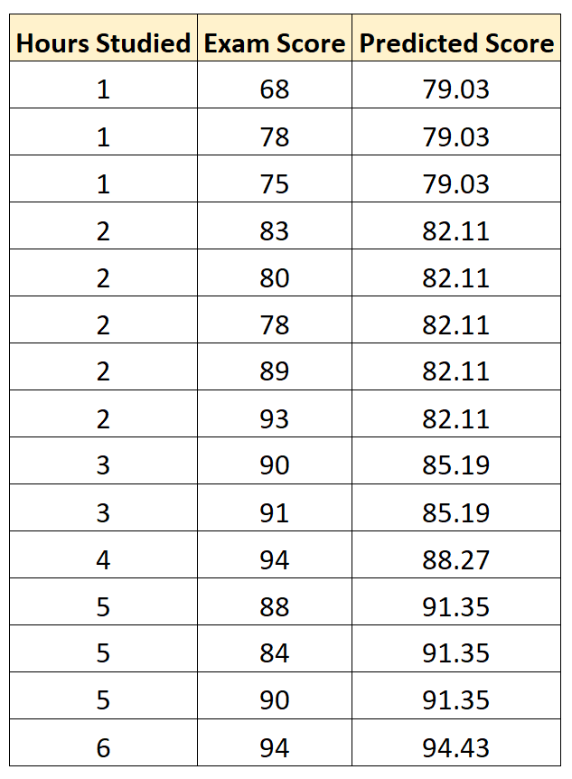
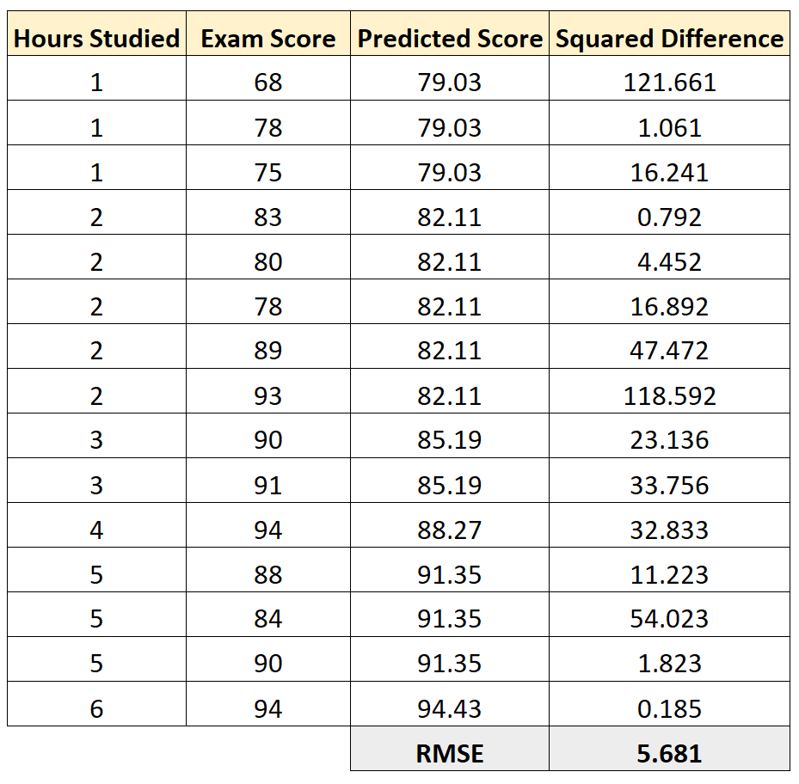
Root Mean Square Error (RMSE) contd…
Example: Predicted exam score of some students, based on how many hours they studied:
Solution: Calculate difference and square it to get squared difference and calculate the mean of it then square root of which gives RMSE

Slide 15
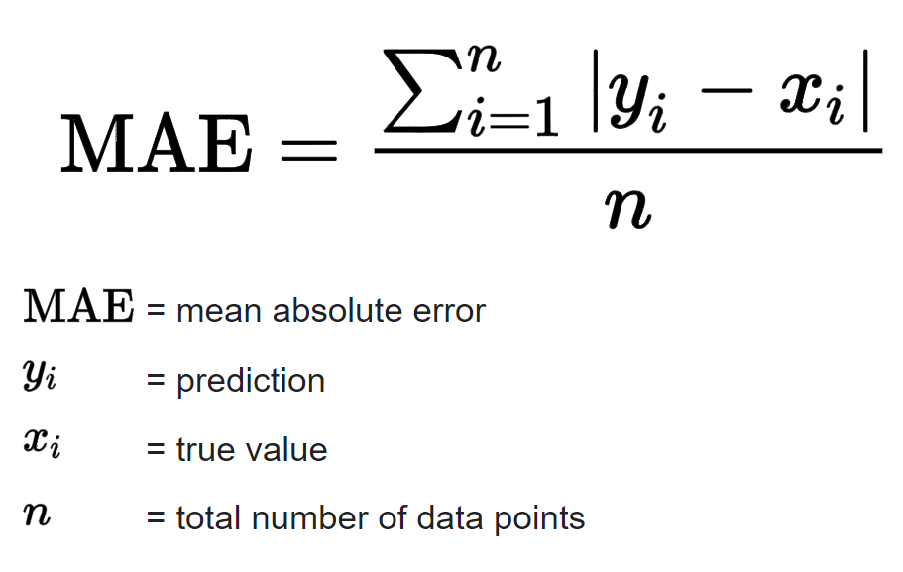
Mean Absolute Error (MAE)
Mean Absolute Error (MAE) is a measure of the average size of the mistakes in a collection of predictions, without taking their direction into account. It is measured as the average absolute difference between the predicted values and the actual values and is used to assess the effectiveness of a regression model.

